Slide 1

NERL GUI
By Haran Cohen

Slide 2
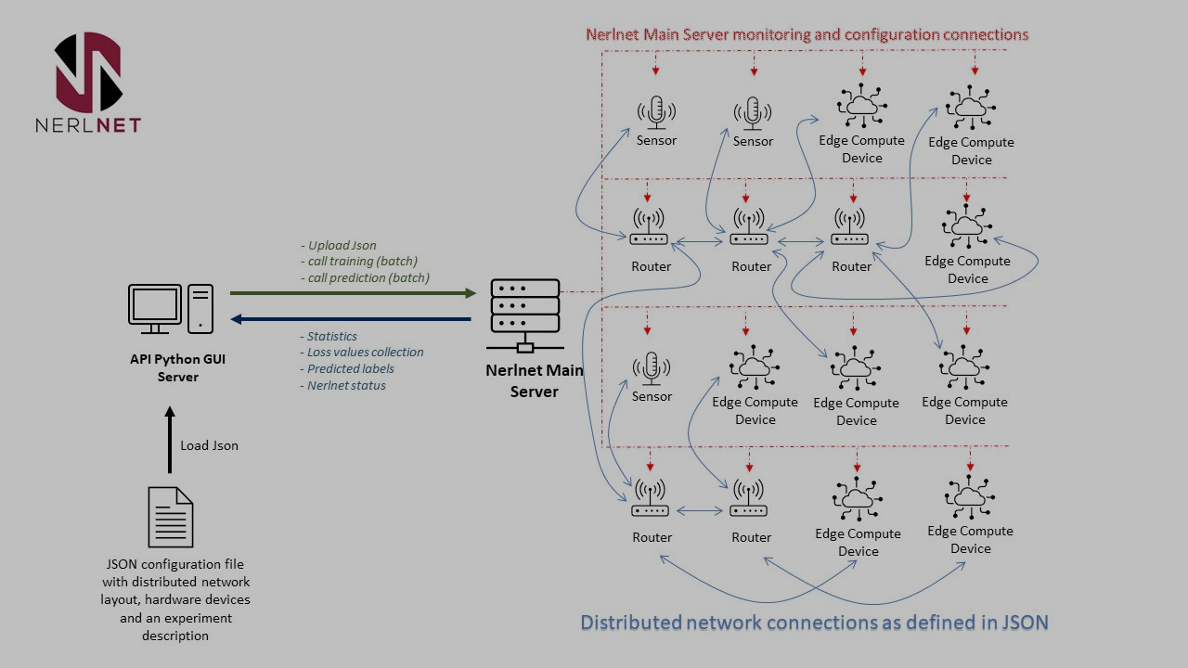
What is Nerlnet?

Slide 3
With NerlGUI:
NerlGUI

Slide 4
Nerlnet + NerlGUI Goal Architecture
Nerlnet Components
NERLGUI
Server
NerlNet Main Server
Stats/Info
Control
Monitor and Guard

Slide 5
Problems along the way
Minimal stats in system
Communication pathing and syntax is unclear
Python server needs ack from every entity?
When? How? Why?
Nerlnet Components
NERLGUI
Server
NerlNet Main Server
Stats/Info
Control
Monitor and Guard

Slide 6
How NerlNet initializes: The Jsons
Each host has
JSONs are used to plan the network:
Architecture:
General Net settings (freq, batch size)
What entities each host holds (by name)
How to create these entities (cowboy port, work mode, connections….)
Comm network:
The router connections
Experiment Flow:
What data each source holds
Which workers to send the data

Slide 7
How NerlNet initializes: The Entities
Each host opens a listener
Python server sends mainServer’s host CSV PATH to use
mainServer propagates this PATH in the network
Each host initializes the entities on it
Each entity has its own cowboy server
Entities wait for messages in idle state

Slide 8
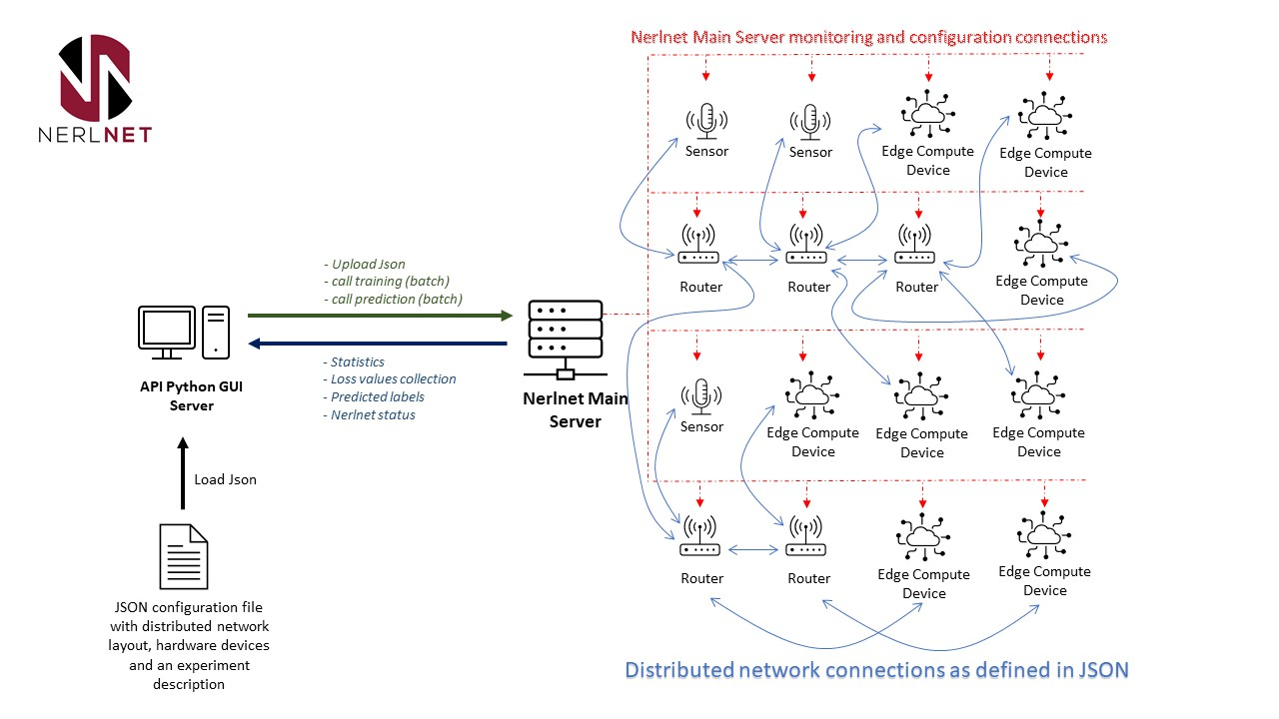
Entity Actions / States
Source / sensor:
"/updateCSV “
"/startCasting”
"/stopCasting “
"/statistics “

Slide 9
Entity Actions / States
Client:
"/init“
"/statistics”
"/clientTraining“
"/clientIdle“
"/clientPredict“
"/weightsVector“
"/federatedWeights"

Slide 10
Entity Actions / States
MainServer:
"/updateCSV“
"/csvReady “
"/lossFunction “
"/predictRes “
"/sourceDone “
"/clientReady “
"/clientsTraining“
“/statistics”
“/clientsPredict”
“/startCasting”
“/stopCasting”
“/[…]”

Slide 11
Entity Actions / States
Router:
"/updateCSV“
"/csvReady “
"/lossFunction “
"/predictRes “
"/sourceDone “
“/clientIdle”
"/clientReady “
"/clientsTraining“
“/statistics”
“/clientsPredict”
“/startCasting”
“/stopCasting”
“/federatedWeightsVector”
“/federatedWeights”
“/[…]”

Slide 12
General Entity Design and message passing
Router
STATE:
Network map (for requests),
Name, Message Counter
Misc fields….
*Cowboy MUST reply to any request, so each entity replies with “ ”
Cowboy Server
Call to next Entity (ignore reply)
Internal gen_state/server
Call specified by Message Body
Message for Entity

Slide 13
General Entity Design and message passing
Router
STATE:
Network map (for requests),
Name, Message Counter
Misc fields….
May be possible to not use cowboy at all and only use erlang’s message passing?
Cowboy Server
Call to next Entity (ignore reply)
Internal gen_state/server
Call specified by Message Body
Message for Entity

Slide 14
The GUI: Opening Screen
General information: Warning / error messages of entity failure, or missed messages:
s1 is disconnected
- w1 is disconnected
Nerlnet Graph
Main Server Status
Routers
Statistics
Communication Performance
Nerlnet Json files Generator GUI
Device Control

Slide 15
Network Graph:
Uses Graphviz
MUST be opened first to verify that Nerlnet is up and that the GUI is connected
W1
W2
W3
S3
R1
R2
MainServer

Slide 16
NerlGUI Design
NERLGUI app
Each object has a state:
Network map (for requests),
Pointers to labels (to update stats)
Router Frame
(wx_object)
Cowboy Server
Server Frame
(wx_object)
wxObject actions
Opening Frame
(wx_object)
wxObject actions
Stats/Info
Stats/Info
Graph Frame
(wx_object)
wxObject actions
Control Frame
(wx_object)
Control Frame
(wx_object)
*Each wx_object is of type gen_server
(no states, only react to external mes)
Control Frame
(wx_object)

Slide 17
NerlGUI message passing, same as NerlNet
Button to open new screen is pressed
Init new wx_object
Save pointer in mainScreen
mainScreen tells child to start a timer to probe relevant entities:
Initialize any objects in child screen
Every round:
Send message to relevant entities
Get response in mainScreen cowboy
mainScreen passes info to relevant child screen
Screen refreshes relevant labels with info
repeat
When window is closed => timer terminates

Slide 18
NerlGUI message passing, a better way
Button to open new screen is pressed
Init new wx_object
Save pointer in mainScreen
mainScreen starts a timer to probe relevant entities:
Initialize any objects in child screen
Every round:
Send message to relevant entities and get an IMMEDIATELY and update info
repeat
When window is closed => timer terminates

Slide 19
Current problems
Message passing format (body) is unclear and not consistent, making it hard to debug
Unclear which of the jsons is up to date, and which setting are necessary and which are redundant
Each entity is unsupervised, making it impossible to implement the guard functionability right now
System may arrive at unplanned states, has memory leaks, other bugs and inefficiencies (but maybe I’m using it wrong)

Slide 20
Lessons for the future
Create standardized formats for message passing, settings values, file locations, etc.
Write it in the git wiki (comments are not enough)
GUI should use the reply of the request, unlike other NerlNet entities
Expand monitoring stats and Guard functionality by adding supervisor entity on each host / an ETS table for each entity that the GUI can save and re-init somewhere.
Better understanding of python and cpp parts of project

